Slide 1
Literature Review Presentation
Group 12
AlphaClean: Automatic Generation of Data Cleaning Pipelines
Notes:
Hello everyone, this is Group 12, and welcome to the literature review presentation about AlphaClean: automatic generation of data cleaning pipelines.

Slide 2
Outlines
What is Data Cleaning?
Problem
AlphaClean
AlphaClean Structure
AlphaClean Architecture
Repair
Quality Functions
Search Algorithms
Experiments
Conclusion
Notes:
Here, we have the outlines of our literature review.
I, Geongu Park will be talking about “What is Data Cleaning”, the problems of typical data cleaning process, what is alphaclean, the comparison between typical data cleaning structure and alphaclean structure, and simple alphaclean architecture.
Sowmya Nethagani will be talking about the details Search Algorithms that is a crucial part in the alphaclean architecture.
Khiem T. Truong will be talking about the experiments, benchmarks and conclusion.
Then, lets start.

Slide 3
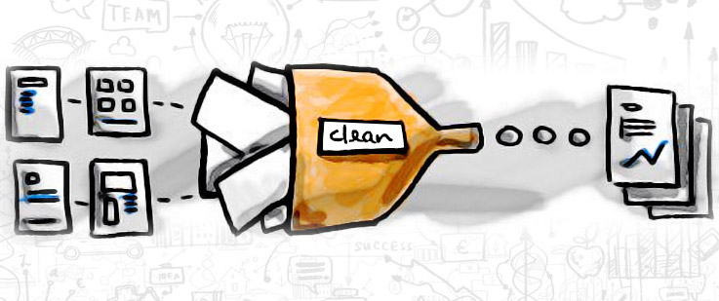
What is Data Cleaning?
Data cleaning is the process of fixing or removing incorrect, corrupted, incorrectly formatted, duplicate, or incomplete data within a dataset.
Notes:
What is Data Cleaning?
Whenever, we work on the raw data, we can observe a lot of incorrect, corrupted, incorrectly formatted, duplicate, or incomplete data within a dataset. Therefore, the data cleaning process is necessary to avoid a poor performance of models when trained using uncleaned data. So, the data cleaning is basically removing those unnecessary data that could lead to a poor performance from the dataset.
Then, what is a typical process of data cleaning?

Slide 4
Problem
Previously, the data cleaning process were done by the design of hand-written scripts.
Now, the trend is to build and tune complex pipelines of “automated” data cleaning frameworks.
However, the hyperparameter tuning is very demanding.
Analysts spend up to 80% of analysis time during data cleaning and preparation.
Notes:
When we try to clean the data, most of us have experienced writing a python script to remove duplicates, NULL values, and etc using pandas library. This is called a design of hand-written scripts.
However, nowadays, the analysts effort in data cleaning is gradually shifting away from the design of hand-written scripts to building and tuning complex pipelines of automated data cleaning libraries.
Here we use the hyperparameter tuning techniques. But, Hyperparameter tuning for data cleaning is very different than the hyperparameter tuning for machine learning since the pipeline components and objective functions have structure that tuning algorithms can exploit.
Also, it is mentioned in the paper that the analysts report spending upwards of 80% of analysis time during data cleaning and preparation.
Therefore, the systems to automatically optimize these pipelines and their parameters are desirable.

Slide 5
AlphaClean
automated data cleaning pipeline library
9x higher quality
significantly more robust
Notes:
As we have libraries like pandas to use in hand-written scripts for data cleaning, we also have frameworks that provides automated data cleaning process for users.
And the Alpha Clean is one of them that finds solutions of up-to 9 times higher quality than naively applying state-of-art parameter tuning methods, which is significantly more robust to straggling data cleaning methods and redundancy in the data cleaning library.

Slide 6
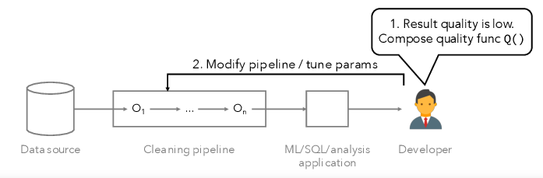
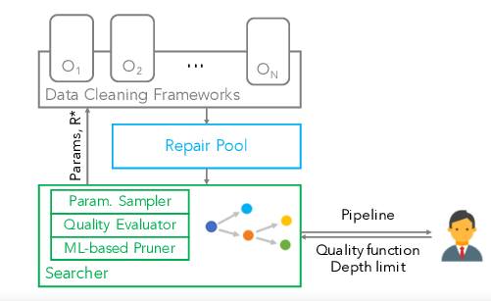
AlphaClean Structure
Typical Cleaning Pipelines
AlphaClean Framework
Notes:
As we can see from the above figure about typical cleaning pipelines, human-in-the-loop is necessary to have a good quality result.
Such as (1) composing a quality function to characterize the suspicious quality issues,
and (2) modifying the data cleaning pipeline to address the errors.
the space of possible operator pipelines and parameterizations of each operator is exponential in the number of operators, parameters, and pipeline depth, and is infeasible for human to manually search for optimal parameters.
However, AlphaClean improves this human-in-the-loop process by providing an expressive, composable quality function, and automatically searching for cleaning pipelines.
AlphaClean decouples sampling from the parameter space from search. This allows the user to iterate quickly by observing early best-effort results.
As we can see from the figure of alphaclean framework,, there is no human interaction and user only gets the result of the optimal pipeline.

Slide 7
AlphaClean Architecture
Generate-then-search framework
each pipelined cleaning operator contributes candidate transformations to a shared pool
Notes:
Basically, AlphaClean is an API interface for existing data cleaning libraries.
In simple English, there are multiple candidate data cleaning frameworks, and AlphaClean automates the process to choose the best candidates to include in the optimal solution.
The simple architecture of the AlphaClean is as follows,
Each framework runs in a separate thread and continuously reruns with new parameters provided by the parameter sampler.
Its outputs are added to the repair pool.
Quality Evaluator computes the quality of a candidate pipeline.
Lastly the ML-based Pruner removes repairs from this pool to expand the set of candidate cleaning pipelines and sends the best pipelines so far based on the result of Quality Evaluator to the user.
The detailed architecture of each steps will be described in the following sections.

Slide 8
Search Algorithm
Parameter Sampler
1. Attribute name Parameter
2. Threshold parameter
Parallelization
1.Search Parallelism
2.Data Parallelism
Learning Pruning Rules
Notes:
In this slide we are going to discuss about the search algorithm which gives the system optimization.
Firstly we are going to see about the PARAMETER SAMPLER: Has two parameters such as
Attribute name parameter: AlphaClean will infer the domain of permitted values
Threshold parameter: Thresholds, inference parameters, and confidence bounds are all examples of numerical parameters. The most and least restrictive endpoints of the value domain are specified, and AlphaClean sweeps the area from most to least restrictive.
Secondly, PARALLELIZATION:
Composing and evaluating Q(s′(R)) is most expensive search operation, even with incremental evaluation. So we parallelize data partitions and candidate pipelines.
Search Parallelism: Pipelines and their qualities are sent and the receiving worker recomputes the pipeline results. This ensures that the priority queue is distributed evenly across all workers in the next iteration.
Data Parallelism: Many large datasets naturally partition themselves, for example, by timestamp or region. The goal is to partition the dataset so that errors are limited to a small number of records. Users can also define their own partitioning functions. In our current implementation, user-specified blocking rules are used to partition the input relation by row.
LEARNING PRUNING RULES:
AlphaClean employs data parallelism to perform parallel searches for each block of the dataset where each block produces an optimal cleaning pipeline. As a set of training examples, AlphaClean models the optimal cleaning pipeline for each block. Cach conditional assignment c in a block's optimal cleaning plan s* is labeled as a positive training.AlphaClean employs a Logistic Regression classifier that favors false positives over false negatives (i.e., keeping a bad search branch) (e.g., pruning a good branch). This is accomplished by training the model and adjusting the prediction threshold until no False Negatives occur.
FEATURIZATION:
The features direct AlphaClean to the data cleaning methods/parameter settings that have shown the most promise in previous blocks. AlphaClean employs a linear classifier as it can be trained quickly. If we apply a deep learning approach to a large enough number of cleaning problems that share a common set of data transformations , we may be able to automatically learn the features themselves.

Slide 9
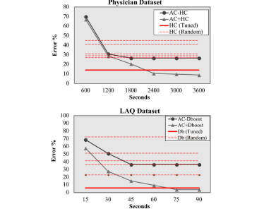
Experiments
Compare with modern blackbox hyper-parameter tuning algorithm
Datasets: Hospital, London Air Quality (LAQ), and Physician
Notes:
To test Alpha Clean’s performance, it was compared with modern blackbox hyper-param tuning algorithm such as HoloClean. The tests are performed on datasets (Hos, LAQ, Phys) which were used in prior data cleaning benchmarks, each with different sizes and cleaning needs. In this figure, AlphaClean is compared against single standalone systems that address functional dependencies (Holoclean HC) and numerical errors (DBoost). The result shows that AlphaClean can support both errors type and work with variety of frameworks. Eventhough single data cleaning method can optimize the quality on its own, HC got 86% while AC without HC got 73%, but together, using AC+HC gets the result to 91%, showing how AC help addresses the weak spots of the methods, similar thing is shown with the result of other systems.

Slide 10
Conclusion
AlphaClean canonicalizes their repairs as conditional assignment operations.
Their outputs contribute to a pool of conditional assignments.
Leveraging advances in planning and optimization can solve a range of data cleaning benchmarks, they are counter-intuitive
Notes:
This defines a well-posed search space, namely, the set of all pipelines composed of conditional assignments.
because of greedy nature of the system and its enormous search space.

